Slide 1
Movie Recommendation System Using Collaborative Filtering
By Mike Wu, Deepti Garg and Unnathi Bhandary
Name : Parth Satyen Shah
Rollno : 1911099
Batch:B2

Slide 2
Objectives
This paper aims to:
To provide a brief overview on recommendation system .
To present the understanding of the technique of collaborative filtering for building a recommendation system.
Understanding the data preparation and data analysis approach using Apache Mahout.
And providing a qualitative evaluation of the techniques used.

Slide 3
Overview
A recommendation system or recommendation engine is a model used for information filtering where it tries to predict the preferences of a user and provide suggestions based on these preferences.
These systems have become increasingly popular nowadays and are widely used today in areas such as movies, music, books, videos, clothing, restaurants, food, places and other utilities.
Businesses basically use these systems to collect information about users preferences and behavior, and then use this information to improve their decisions in the future

Slide 4
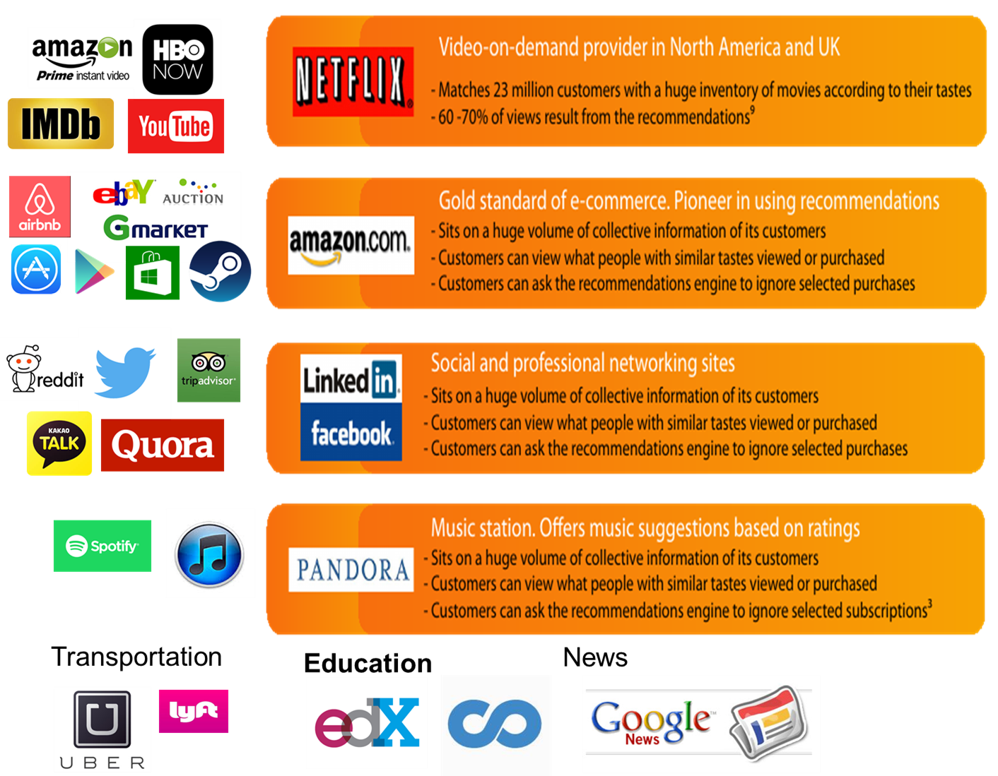
Examples

Slide 5
Types of recommendation systems
3 main types:-
Collaborative filtering
Content based filtering
Hybrid System

Slide 6
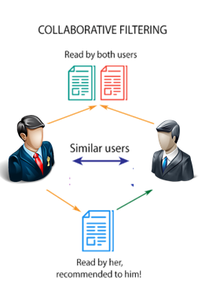
1.Collaborative Filtering
Collaborative filtering methods are based on collecting and analyzing a large amount of information on users’ behaviors, activities or preferences and predicting what users will like based on their similarity to other users.
There are two kinds of collaborative filtering systems .
1.User-based recommender
2. Item-based recommender.

Slide 7
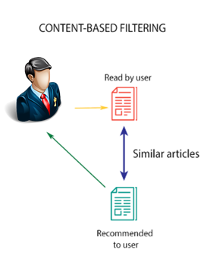
2.Content Based Filtering
Content-based systems considers the description and features of an item along with the user’s preferences to provide suggestions.
In other words, these algorithms try to recommend items that are similar to those that a user liked in the past (or is examining in the present).

Slide 8
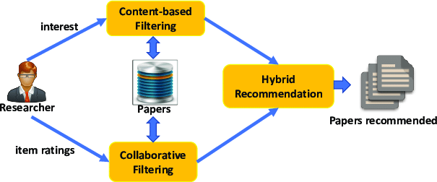
3.Hybrid System
Hybrid recommendation systems are a combination of both collaborative and content-based filtering methods.
In these type of systems, collaborative and content-based predictions are performed separately and then the results of both techniques are combined to provide recommendations.

Slide 9
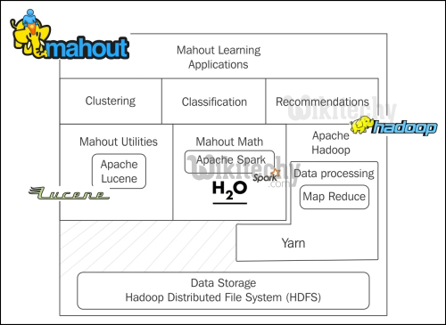
Apache Mahout
Highly analytical library
Based on the Apache Software Foundation.
Produce free, distributed and scalable implementations of advanced machine learning algorithms used in the fields of clustering, classification, collaborative filtering, and frequent pattern matching.
Many of the implementations is used in the Apache Hadoop platform.
It includes implementations of powerful algorithm like Loglikelihood Similarity, Pearson Coefficient, Cosine Similarity- to name a few.

Slide 10
Implementation
The authors propose a collaborative movie recommendation system that focuses on the ratings given by the users to provide recommendations.
Their system is designed using apache mahout which is built on top of the Hadoop platform.
They have used the similarity/correlation between movie items to build this system, employing both user-based and item-based collaborative filtering techniques.
In this section, we describe the intricacies of the two approaches of collaborative filtering.

Slide 11
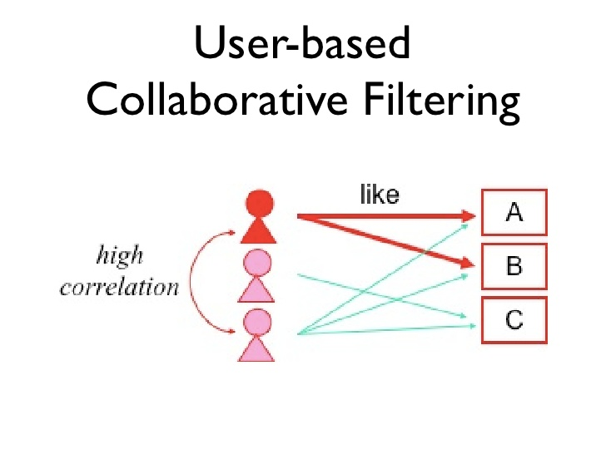

Approach 1
User Based Filtering :
Use user-item rating matrix
Make user-to-user correlations
Find highly correlated users
Recommend items preferred by those users
Pearson’s Correlation:

Slide 12
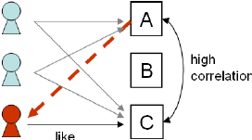
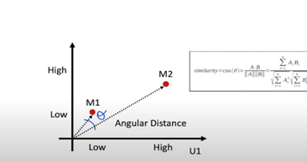
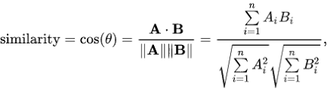
Approach 2
Item-based
Collaborative Filtering
Item based filtering :
Use item-user ratings matrix
Make item-to-item correlations
Find items that are highly correlated
Recommend items with highest correlation
Cosine Similarity:

Slide 13
Process
Step1 : Collection of data
The movies dataset used in the paper was obtained from the Yahoo Research Web scope database.
The database provides two files namely
1.Movies User Ratings
2.Descriptive Content Information.
The Movies Users Ratings file contains 211231 records and consists of User ID, Movie ID and Ratings.
The Movies Descriptive Content Information file contains 54058 records
and consists Movie ID, Title, Genre, Directors, Actors and so on.

Slide 14
Step 2: Data Cleaning
The Movies Descriptive Content Information file contains huge number of columns. Most of these columns were not required for our experiments and hence were removed.
The dataset also contained a lot of blank values and duplicate values which needed to be resolved.
In addition, there were some entries for movies in the Movies Users Ratings files that didn’t correspond to any movie in the Movies Descriptive Content Information file. These entries were removed for easier processing.

Slide 15
Step 3. Data Analysis
Data analysis was done to gain insight into the movie dataset that could help in developing our system using the Matplotlib libraries in Python.
Patterns such as most rated movies, most rated genres, the number of movies in each genre and the number of movies rated in each rating category as shown .

Slide 16
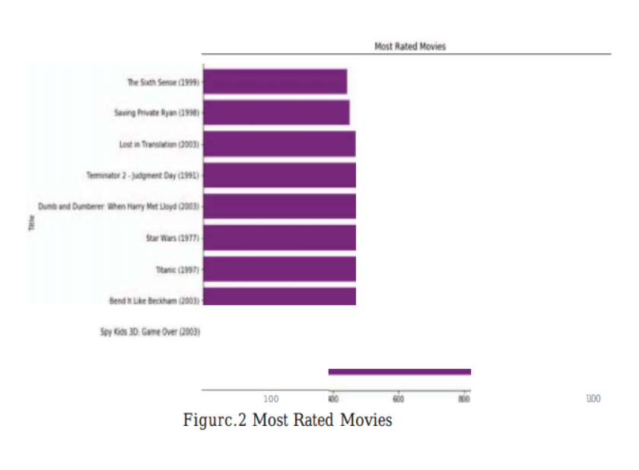
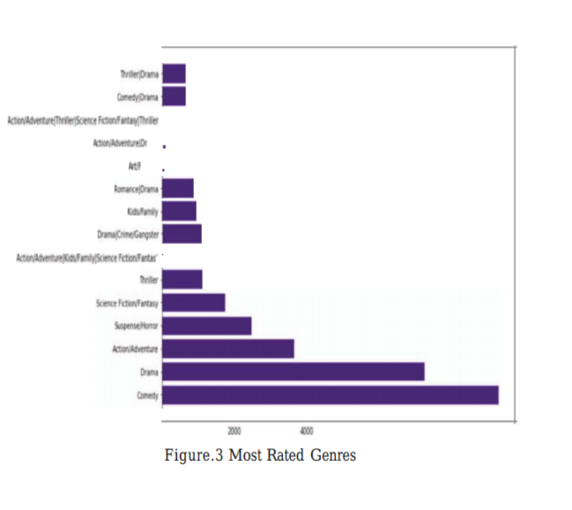
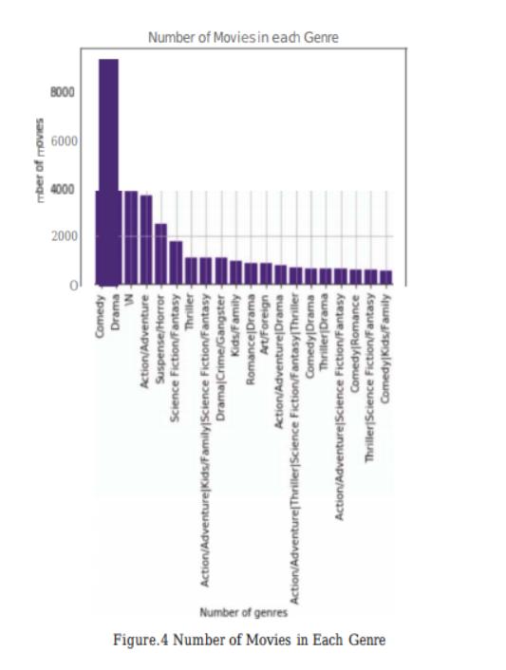

Slide 17
Step 4: Model Building
The authors have used Mahout library to build the recommender system.
For User based filtering ,
The User Similarity class in addition to the Pearson Correlation Similarity which uses the Pearson Correlation Coefficient to determine the similarity between users' ratings; hence the preference.
The User Neighborhood is computed by using another machine learning algorithm of distance-based clustering called, NearestNUserNeighborhood where N is defined in the program code.
Nearest Neighbor algorithm searches the N nearest data-points around each data-point to get the most similar data-points and group them together.

Slide 18
For item-based filtering,
We use Item Similarity class of Mahout. The machine learning algorithm used to compute the item similarity is LogLikelihoodSimilarity. Since the items are static, their similarities based on the user ratings are not going to change over time, we can precompute them and store them offline.
The results from the Item Based recommender is loaded to the Hadoop Distributed File System (HDFS) to have a scalable and fault-resistant storage.
The User Based recommender results have to be computed every time during a recommendation since unlike items, ratings provided by users.

Slide 19
Model Evaluation
Qualitative Evaluation
The movie recommender system built in this paper facilitates the understanding of how a recommender system works. To evaluate the accuracy and relevancy of the results produced by our system, we analyze both the approaches differently.

Slide 20
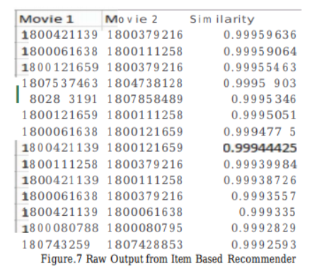
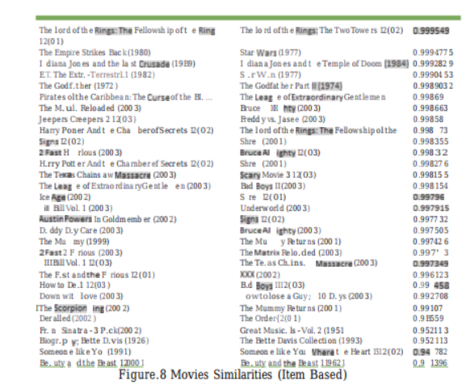
For item-based filtering :
We compare the Item based similarity coefficient results as given in Figure by mapping the MovieID of Movie 1 and Movie 2 to their titles.
Using Python pandas libraries, we get the result as shown in Figure. As evident from the table, movies which are similar are given a higher similarity metric.

Slide 21
For user based filtering :
For user-based recommender system, we evaluate the model using the AverageAbsoluteDifferenceRecommenderEvaluator.
We divide the training data into test and train samples. Next ,we evaluate the rating predictions on test data against the actual ratings as specified in the training data.

Slide 22
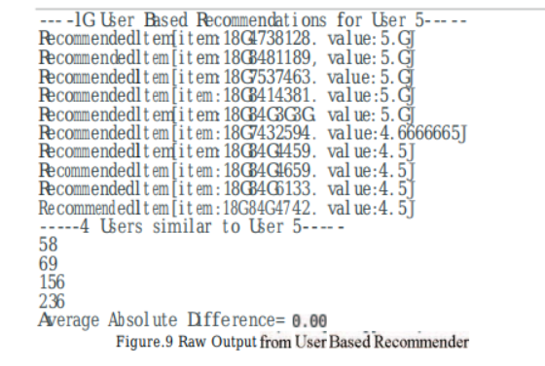
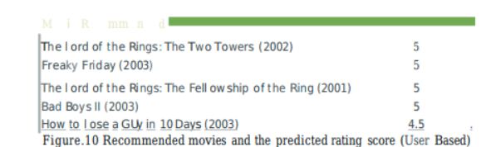
Figure shows the raw output from the user based filtering technique.
The system recommends 10 movies to user (User 5) and returns the nearest neighbors which have most similar taste preference as him. For each movie recommended, it also predicts the ratings by that user (User 5). We get an average absolute difference of 0 which proves that the predictions made on the ratings of the recommended items are 100% accurate.
Figure shows the table of recommended movies with the movie title and predicted ratings.

Slide 23
Common Issue Evaluation
2 problems
Firstly, the New User Problem is concerned with the scenario when a new user is added to the recommender system. There are no ratings provided by him/her for any movie in the system yet. This is also called a User Cold Start.
One simple possible resolution can be to recommend top rated movies or most recently added movies to this new user.

Slide 24
Secondly, there is a concern that no new item is recommended. It can be understood as an Item Cold Start problem. When a new movie is added to the system, it does not have any ratings associated with it. How can it be discovered and recommended?
One resolution can be to recommend movies similar to the genre of top rated movies. If the new movie falls in that genre, it will get discovered . However, in this resolution, we will need to build a system based on the genre of the movies.

Slide 25
Conclusion and future work
In this paper the authors have implemented a movie recommendation system using collaborative filtering. This system is developed using Apache Mahout and takes the ratings given to movies into consideration to provide movie suggestions.
Recent research indicates that hybrid systems are found to be more effective and provide more accurate recommendations. Hence, hybrid systems would be an improvement. Our system considers the user ratings to recommend movies. In the future, more features such as the genre of the movie, the directors, the actors and so on could be considered as well to provide suggestions.

Slide 26
In addition, a new framework called Apache Prediction 10 could be looked into to develop the system instead of Mahout.
The Apache Prediction 10 is a machine learning server that uses the technology stack of Apache Hadoop, Apache spark, Elastic Search and Apache Hbase to build Universal Recommender System.

Slide 27
Strategy for Implementation
Anaconda platform
Jupyter notebook for open source python
Use movie dataset
Link : https://www.kaggle.com/rounakbanik/the-movies-dataset
Perform item-item collaborative filtering

Slide 28
REFERENCES
[1] A. V. Dev and A. Mohan , "Recommendation system for big data applications based on set similarity of user preferences," 2016 International Conference on Next Generation Intelligent Systems (ICNGIS), Kottayam.
[2] Kumar, Manoj & Yadav, D.K. & Singh, Ankur & Kr, Vijay, "A Movie Recommender System: M OVREC ", 2015 International Journal of Computer Applications.
[3] S. G Walunj, K Sadafale , "An online recommendation system for e-commerce based on Apache Mahout framework", 2017 ACM SIGMIS International Conference on Computers and People Research.

Slide 29
[4] H. W. Chen, Y. L. Wu, M. K. Hor and C. Y. Tang, "Fully content-based movie recommender system with feature extraction using neural network," 2017 International Conference on Machine Learning and Cybernetics (ICMLC), Ningbo, China.
[5] Z. D Zhao, M. S Shang ,"User-Based collaborative filtering recommendation algorithms on Hadoop", Proc. of Third International Workshop on Knowledge Discovery and Data Mining, pp. 478-481, 2016.
[6] B. Sarwar, G. Karypis "Item-based collaborative filtering recommendation algorithms", Proceedings of the 10th international conference on World Wide Web.

Slide 30
[7] Koen Verstrepen, Bart Goethals, "Unifying nearest neighbors
collaborative filtering ", Proceedings of the 8th ACM Conference on
Recommender systems, October 06-10,2014, Foster City, Silicon Valley,
California, USA .
[8] Jain, A., & Vishwakarma, S. K., "Collaborative Filtering for Movie Recommendation using RapidMiner" International Journal of Computer Applications (0975 - 8887) Volume 169 - No.6, July 2017.
[9] M. Gardener, "Statistics for Ecologists Using R and Excel (Edition 2) “.

Slide 31
THANK YOU

